Slide 1
GUIDEBOOK
Virtual Innovation Competition
VIC
2025
“Shaping Tomorrow with Innovative Solutions"
https://myvic.asia
Start Now
https://t.me/vicsupportt
digitalevents.secretariat@gmail.com
https://registro.myvic.asia
Powered By:
https://myvic.asia
Registro TUTORIAL
https://myvic.asia/tutorial-registro/

Slide 2
GUIDEBOOK
Strategic Partners
Universiti Teknologi MARA Startup Company
_____________________
_______________________________________________
Strategic Partnerships

Slide 3
https://myvic.asia
GUIDEBOOK
What is Virtual Innovation Competition?
Virtual Innovation Competition is organized by DIGIT360 and Digital Information Interest Group (DIGIT), in collaboration with Information Science Studies, College of Computing, Informatics and Mathematic, Universiti Teknologi MARA (UiTM) Kelantan Branch, Malaysia; Universitas Ngudi Waluyo, Indonesia; Camarines Sur Polytechnic Colleges, Philippines; Indian Innovators Association, India; The Union Of Arab Academics, Yemen; Nusantara Training and Research, Indonesia; Academica Press Solutions; RR Texnology and Laman Teknologi.

Slide 4
GUIDEBOOK
VIC History
2020
2021
2022
347
672
872
VIC2025
PEOPLE JOIN
PEOPLE JOIN
PEOPLE JOIN
Online innovation event featuring diverse projects.
2023
2024
1012
1344
2025 FORECAST
PEOPLE JOIN
PEOPLE JOIN
1500+
PEOPLE JOIN

Slide 5
GUIDEBOOK
VIC
Category

Slide 6
https://myvic.asia
GUIDEBOOK
Professional
Category
Open to Academician (Teacher, Lecturer, Academic Consultant, etc.), Practitioners, and Industries.
7 Clusters: Industrial Technology, Energy & Environment, Health & Wellness, Cyber Technology, Logistics & Transportation, Social Creativity & Innovation, and Special Needs innovation.
Professional
RM 150 Local (Malaysia)
USD 100 (International)
Awards:
Academique D’Or
The Best
Medal (Gold, Silver, and Bronze)
e-certificate

Slide 7
https://myvic.asia
GUIDEBOOK
Tertiary
Category
Open to Students at higher education (certificate to PhD)
2 Clusters: Science & Technology (ST), and Social Science (SS)
Awards:
Diamond Award
Medal (Gold, Silver, and Bronze)
e-certificate
Tertiary
RM 100 Local (Malaysia)
USD 50 (International)

Slide 8
https://myvic.asia
GUIDEBOOK
3-Minute Thesis
Category
Open to Students at higher education (degree to PhD)
Awards:
Diamond Scholar Award
Medal (Gold, Silver, and Bronze)
e-certificate
3-Minute Thesis (3MT)
RM 100 Local (Malaysia)
USD 50 (International)

Slide 9
https://myvic.asia
GUIDEBOOK
Young Scientist
Category
Open to Secondary Schools Students (13 years to 17/18 years) from Malaysia and international students. School Authorization Letter is MANDATORY.
Awards:
Diamond Award
No Medal provided
e-certificate
Young Scientist (YS)
FREE (No FEE) – PAJSK Provided
e-certificate provided. Medal can be purchased at the end of the event.

Slide 10
https://myvic.asia
GUIDEBOOK
Junior Scientist
Category
Open to Primary Schools Students (7 years to 12 years) from Malaysia and international students. School Authorization Letter is MANDATORY.
Awards:
Diamond Award
No Medal provided
e-certificate
Junior Scientist (JS)
FREE (No FEE) – PAJSK Provided
e-certificate provided. Medal can be purchased at the end of the event.

Slide 11
https://myvic.asia
GUIDEBOOK
School Authorization Letter
01
Generate School Authorization Letter Template View Tutorial
02
Please attached the letter with the school’s official letterhead and obtain the signature as well as the official stamp.
03
Upload the document/letter to Google Drive – set permission to ‘anyone can view’.
04
Copy the Google Drive URL and paste it together when submitting the Video.
Download PAJSK Approval Letter [KPM]
https://drive.google.com/drive/u/1/folders/16cWMVrNxb9bedEmQy7XnJsH0k_mcRuEc
Registro TUTORIAL
https://myvic.asia/tutorial-registro/

Slide 12
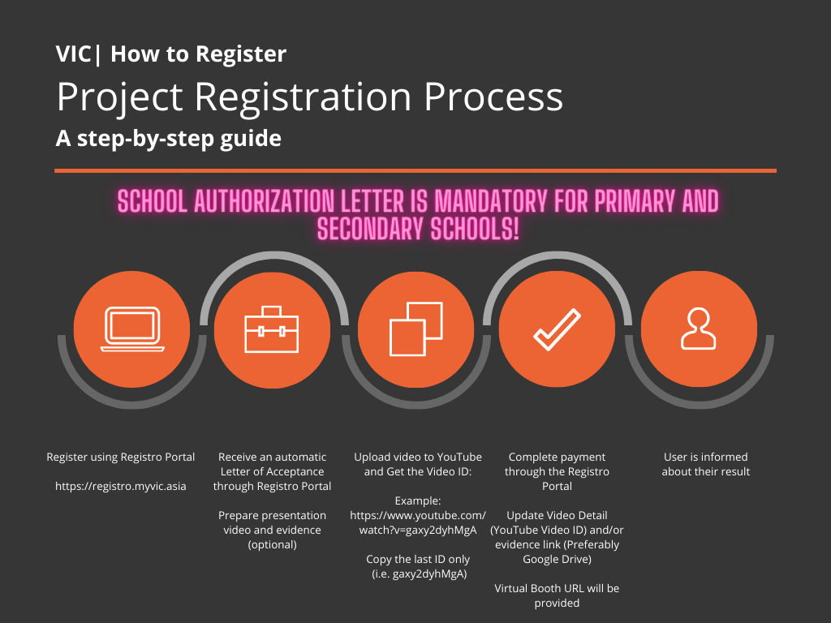
GUIDEBOOK
VIC
How-To-Register

Slide 13
GUIDEBOOK
Register your project at Registro Portal: https://registro.myvic.asia
A letter of Acceptance (LOA) will be automatically issued for the accepted project. Please check Registro Portal for the copy of the PROJECT ID (I.E. YS10, 3MT1, SS1, ST1)
Upload your video to your YouTube account. Please ensure that you set the permission to public or unlisted.
Pay the participation fee via Registro Payment System (for categories with Fee).
Upload your video link, and evidence (optional – preferably Google Drive) via Registro Portal.
For Young Scientists and Junior Scientists category, you are required to attach an approval letter from the school.
The letter can be GENERATED via Registro (see Video): View Tutorial
Please attached the letter with the school’s official letterhead and obtain the signature as well as the official stamp.
Then, upload the document/letter to Google Drive – set permission to ‘anyone can view’.
The organizer will verify the payment, video, and/or evidence link.
Once verified, the video will be uploaded to VIC Virtual Booth.
A panel of expert reviewers will review all the projects submitted.
Announcement of results through the VIC YouTube Channel, VIC website, and email.
The judges’ decision is final, and no appeals will be entertained.
VIC
How-To-Register

Slide 14
https://myvic.asia
GUIDEBOOK
Video Content – General (Excluding 3MT)
Video Duration: Within 6 Minutes and 30 Seconds
Orientation: Landscape
Submission: Upload to your own YouTube Channel. Please set permission to ‘Unlisted’ or ‘Public’.
Rules
Must start with video introduction of team members – including name, and organization/university name.
Contents – Introduction, problem statement, solution, impacts, commercialization potential, publication (if available), copyright (if available), any additional criteria.

Slide 15
https://myvic.asia
GUIDEBOOK
Video Content – 3-Minute-Thesis
Video Duration: Within 3 Minutes and 30 Seconds
Orientation: Landscape
Submission: Upload to your own YouTube Channel. Please set permission to ‘Unlisted’ or ‘Public’.
Rules
Must start with video introduction of team members – including name, and organization/university name.
Contents – Introduction, problem statement, methodology, findings, discussion, and conclusion.
Additional criteria - Impacts, commercialization potential, publication (if available), copyright (if available), etc.
The Presentation must be in a spoken word only (no poem, singing, voice replacement, etc.).
The presentation must be in eirher English or Bahasa Melayu.

Slide 16
GUIDEBOOK
VIC
Awards

Slide 17
GUIDEBOOK
VIC
Grand Award

Slide 18
GUIDEBOOK
Competition Period
01 March 2025 – 31 May 2025
Entry and Registration Deadline
31 May 2025
Video and Payment Deadline
31 May 2025, before 12.00 p.m.
Judging
June 2025
Announcement of Results
25 June 2024, 11.00 AM
VIC
Important Dates

Slide 19
RM50 /
USD 20 ONLY!
https://myvic.asia
GUIDEBOOK
WHY PUBLISHED WITH US
Paper Publication
Fast publication process.
DOI registered with Zenodo.
The article will be submitted for indexing at OpenAire.
Why Published with Us:
Fast publication process.
DOI registered with Zenodo.
The article will be submitted for indexing at OpenAire.
Selected article will be published in the Malaysia Journal of Invention and Innovation (Without additional FEE).
Minimum publication Fee (RM50)
Submit Now

Slide 20
RM250 / USD 100 ONLY!
https://myvic.asia
GUIDEBOOK
Paper Publication
Malaysia Journal of Invention and Innovation (eISSN: 2976-2170) an international journal that provides leading edge research and findings focussing on theories, methods, invention, innovation, and applications in all fields especially in Social Sciences, Science and Technology, Informatics, Science, and related field of study. Malaysia Journal of Invention and Innovation (MJII) is indexed by:
MyJurnal
International Scientific Indexing (ISI)
Advanced Sciences Index (ASI)
Eurasian Scientific Journal Index (ESJI)
Directory of Research Journals Indexing (DRJI)
CiteFactor
SJIFactor
PUBLICATION OPPORTUNITIES
Fast publication process.
DOI registered with Zenodo.
Double-Blind Review
OpenAire
Google Scholar
Bielefeld Academic Search Engine (BASE)
COSMOS Impact Factor

Slide 21
GUIDEBOOK
Download the Extended Abstract Template: [Download]
Prepare your paper based on the Template provided.
Pay the publication Fee (refer to Table below) [Online Payment]
Submit your Extended Abstract to the following URL: https://academicapress.digit360.com.my/apsp/index.php/publish/
The submission deadline is 31st May 2025.
VIC
How to Submit Paper
OPTIONAL – NOT MANDATORY

Slide 22
GUIDEBOOK
By submitting to VIC, I agreed that:
My information will be collected under the Personal Data Protection Act 2010 (PDPA).
The organiser may contact me for further communication regarding the event that i am a participant.
My registration is consider completed once i pay the registration fee (if applicable) and submitted the presentation video.
No refund is available once I have submitted the complete registration.
The judges’ decision is final, and no appeals will be entertained.
It is NOT ADVISEABLE to enter this competition if you have already won at other events - especially international event as we cannot promise that you will be getting the same result here.
The organiser hold no legal responsibility on any claim by participants - please read the term and conditions accordingly.
VIC
Rules & Regulation

Slide 23
GUIDEBOOK
General Rules and Regulation
VIC is open to all participant from primary schools to professionals.
The participation fee is only applicable for all categories EXCEPT primary and secondary schools.
Participation in primary (Junior Scientist) and secondary schools (Young Scientist) is FREE. However, the organizer only provided an e-certificate of participation and award.
School Authorization Letter is mandatory for primary and secondary schools.
Extra medal for Primary and Secondary schools is available for purchase with a fee of RM50 (local) and USD50 (International) per medal.
The extra medal price is inclusive of delivery and packaging FEE.
For other PAID category, ONE MEDAL is provided for FREE. Extra medal is also available for purchase with a fee of RM50 (local) and USD50 (International) per medal (inclusive of delivery and packaging FEE.).
The organizer only provided ONE e-certificate that included all the participant's name. However, a customized e-certificate that contain each individual participant can be purchased later with a fee of RM15 per e-certificate/individual.
All payment is NON-REFUNDABLE. Failure to complete your registration before the end of submission will VOID your participation.
VIC
Rules & Regulation

Slide 24
GUIDEBOOK
General Rules and Regulation
Junior Scientist (JS) is applicable for primary school's students. The project MUST BE LED by a primary school student. Teacher or supervisor may insert their name as a member. Failure to comply my lead to disqualification of participation.
Young Scientist (YS) is applicable for secondary school's students. The project MUST BE LED by a secondary school student. Teacher or supervisor may insert their name as a member. Failure to comply my lead to disqualification of participation.
Tertiary Social Science or Tertiary Science and Technology is applicable for the STUDENTS of higher learning institution. The project MUST BE LED by a STUDENT. Teacher/Lecturer/Supervisor may insert their name as a member. Failure to comply my lead to disqualification of participation.
Presentation video must not exceed 6 minutes 30 seconds.
The use of third-party-software to boost video view and likes is strictly prohibited. Failure to comply my lead to disqualification of participation.
All decisions are FINAL. No request or appeal will be entertained.
The data collected for the registration process is strictly confidential and will not be shared to other entity.
VIC
Rules & Regulation

Slide 25
GUIDEBOOK
General Rules and Regulation
However, the organizer may use the information for further communication with the participants such as to update the progress of the event and participation in future event.
All presentation video must start with each member introducing themselves via Recorded Video – to ensure originality and consent of all members and advisor (s).
The innovation and/or invention must be original – the organizer will disqualify any innovation and/or invention that did not fulfil the given criteria
VIC
Rules & Regulation

Slide 26
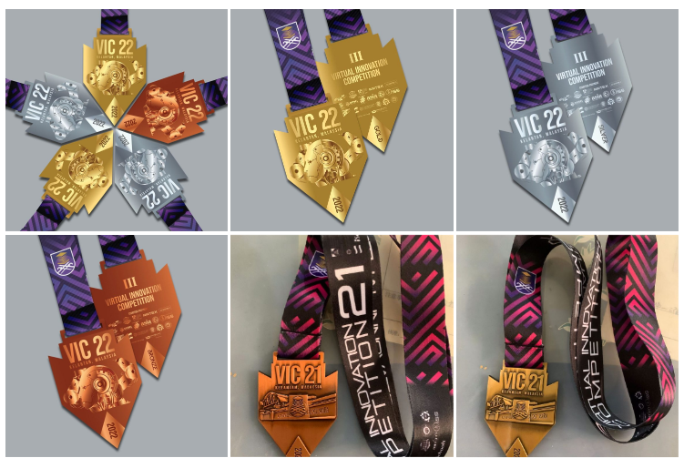
GUIDEBOOK
VIC
Premium Medal
RM50 / Medal
ONLY!

Slide 27
GUIDEBOOK
VIC
Premium Medal
RM50/Medal

Slide 28
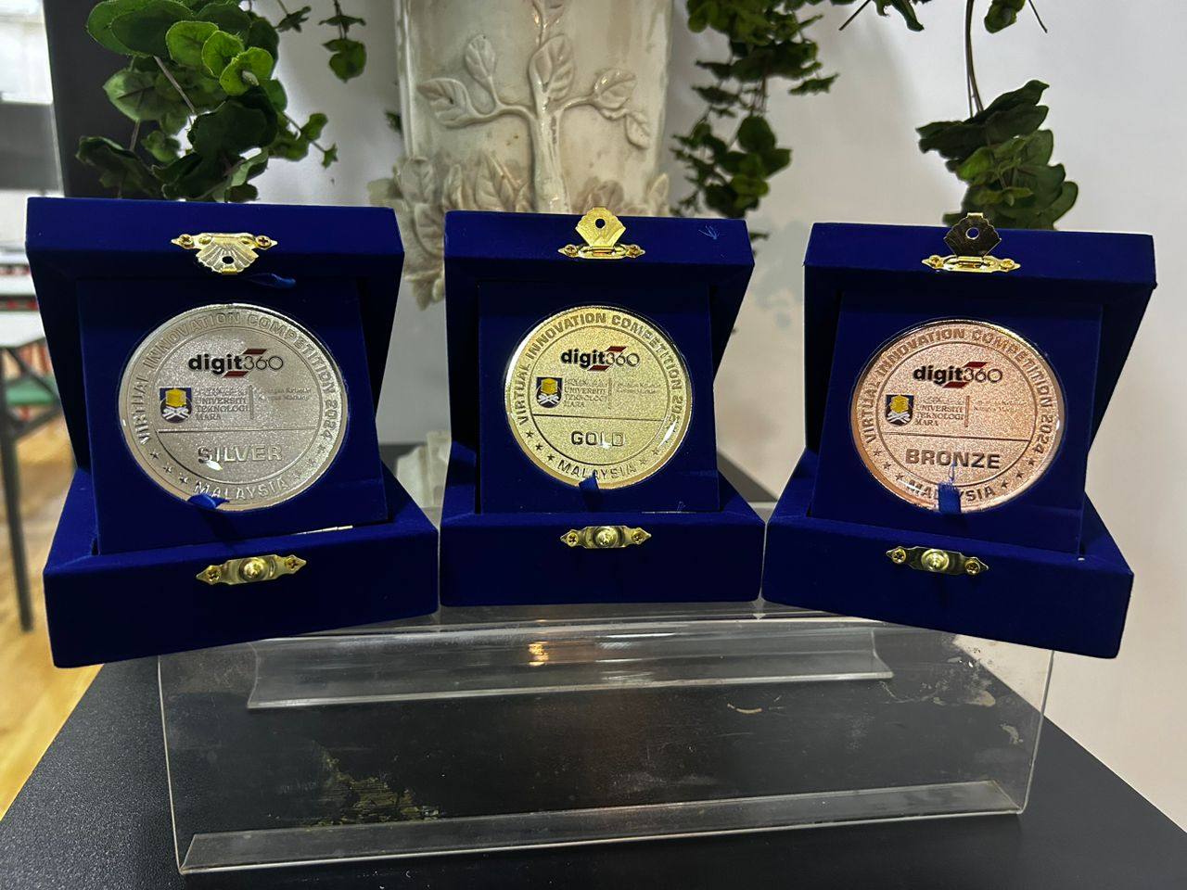
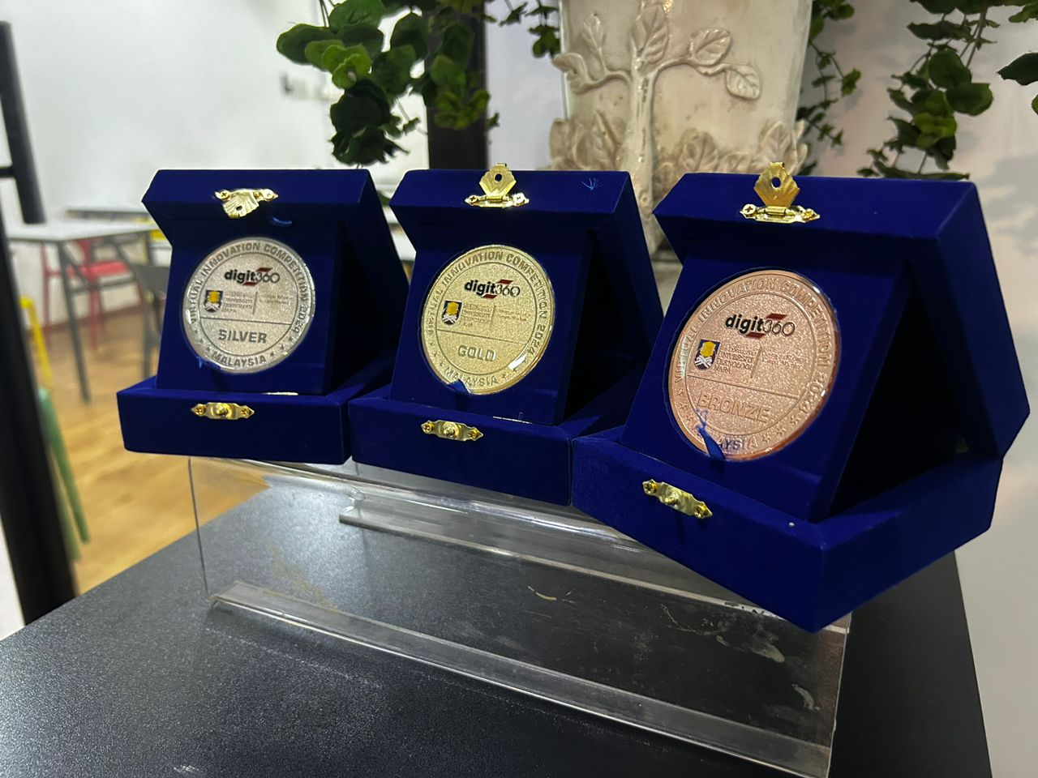
GUIDEBOOK
VIC
Exclusive Medal
RM129.99

Slide 29
We take plagiarism SERIOUSLY! If you have any issue with the project, please click the report button to communicate with us
GUIDEBOOK
VIC
New Features
Integrity is priceless! If you received this message, please ensue that the first name on the registration list is an active student. Please select STATUS=STUDENT.
Registro TUTORIAL
https://myvic.asia/tutorial-registro/

Slide 30
https://myvic.asia
GUIDEBOOK
VIC
Support Channel
WEBSITE
TELEGRAM
FACEBOOK
EMAIL
https://myvic.asia
https://t.me/vicsupport
http://www.facebook.com/vicuitmck
digitalevents.secretariat@gmail.com

Slide 31
GUIDEBOOK
Thank you
For Your Attention
Join us Now! More details at https://myvic.asia
Register Now

